Slide 1
“Major Project”
2016
Submitted as part of Major Project.
VENKAT KARANAM (S160082)
REHMATH BANU (S160281)
DEVI SRINIVAS VASAMSETTI(S160447)
SRINIDHI NASIMSETTI (S160750)
Under the Supervision of:
Mr CH SATISH KUMAR
Assistant Professor
Department of Computer Science and Engineering
Rajiv Gandhi University of Knowledge Technologies
Srikakulam – 532402

Slide 2
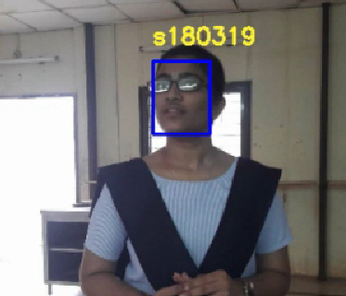
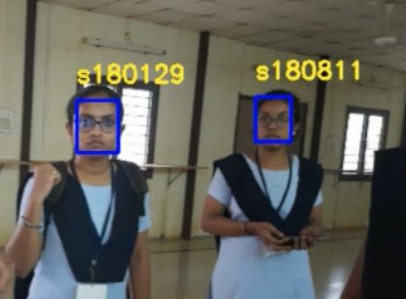
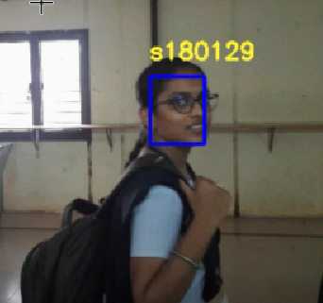
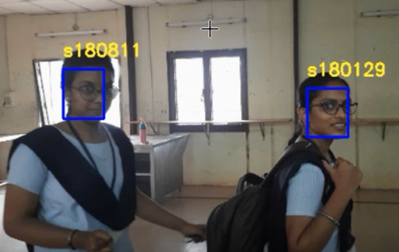
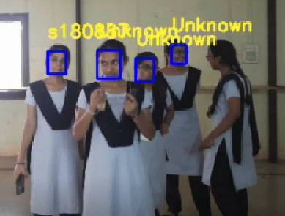
MESS ATTENDANCE AND MONITORING SYSTEM THROUGH FACIAL AUTHENTICATION

Slide 3
Why this project?
Our project mainly aims at taking attendance of the students attending the mess every meal hour through facial authentication.
Students not having meals in the allocate mess.
No proper feedback system.
The Mess administration and the college administration can view the statistics of the students attending the mess.
Also we design an application in a way that it resembles the activities and experiences of students in the mess.

Slide 4
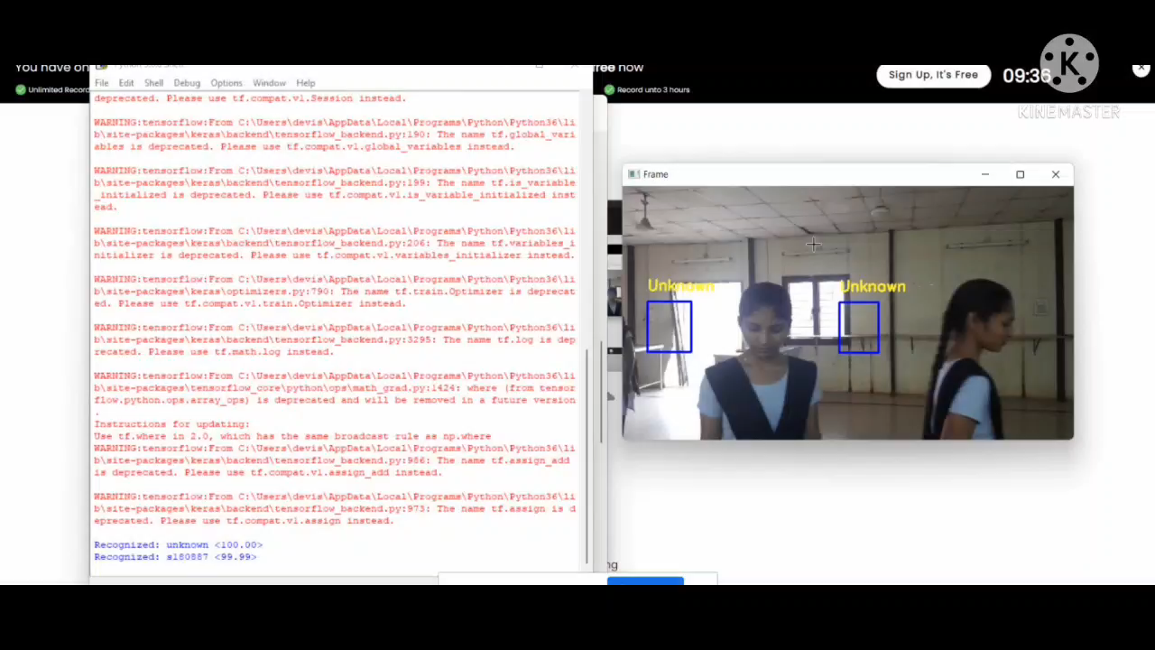
Sample Trail

Slide 5
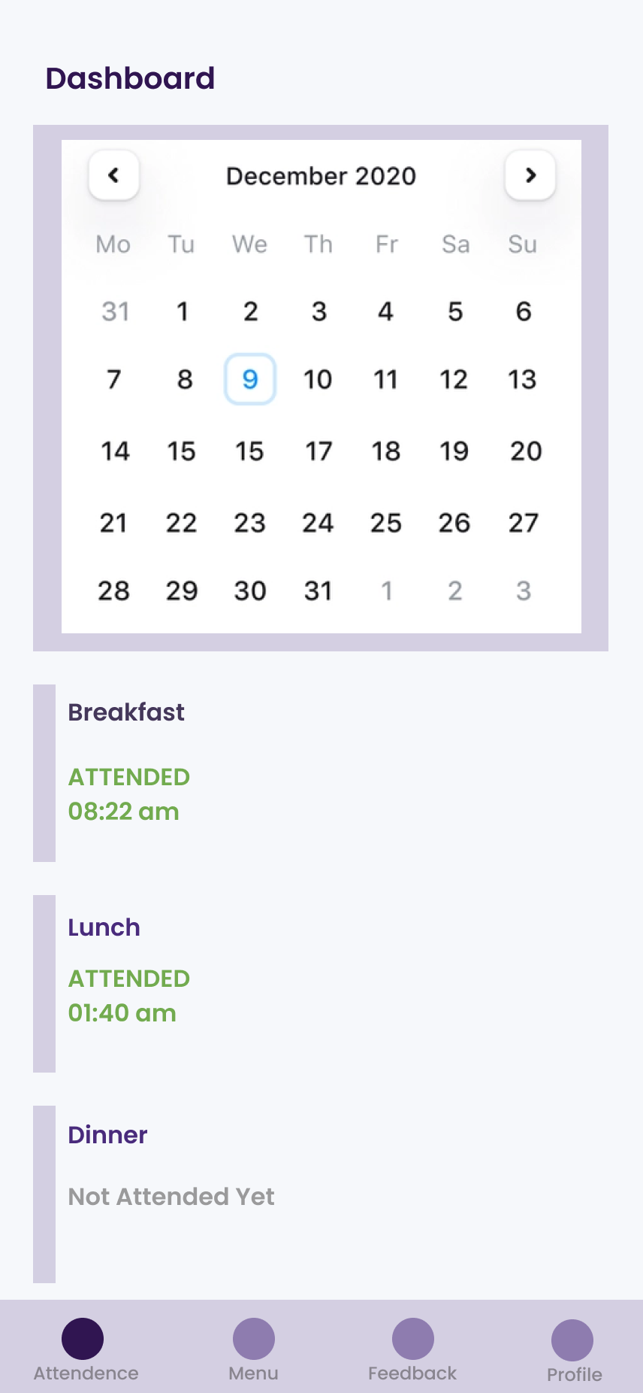
Student Features
1.View their attendance.
2.View the menu for the day.
3.A self contained system for mess feedback ,suggestions and complaints.
4.”Leave the meal” feature to let students leave the meal they are not interested in, or cannot attend which will then be notified to mess manager before the meal is cooked.
5.Meal reminders and notification system.
6.Check out if not present in the campus.

Slide 6
Mess Administration Features
1. Know how many people are willing to leave the meal before preparing the food.
2.Update the menu for the day.
3.Have a track of number of students attending the mess for every meal hour.
4.Get statistics of the attendance on day wise, weekly and monthly basis.
5.View the feedback and suggestions received.
6.View the complaints posted by the students , take necessary action and update the action taken on that complaint.

Slide 7
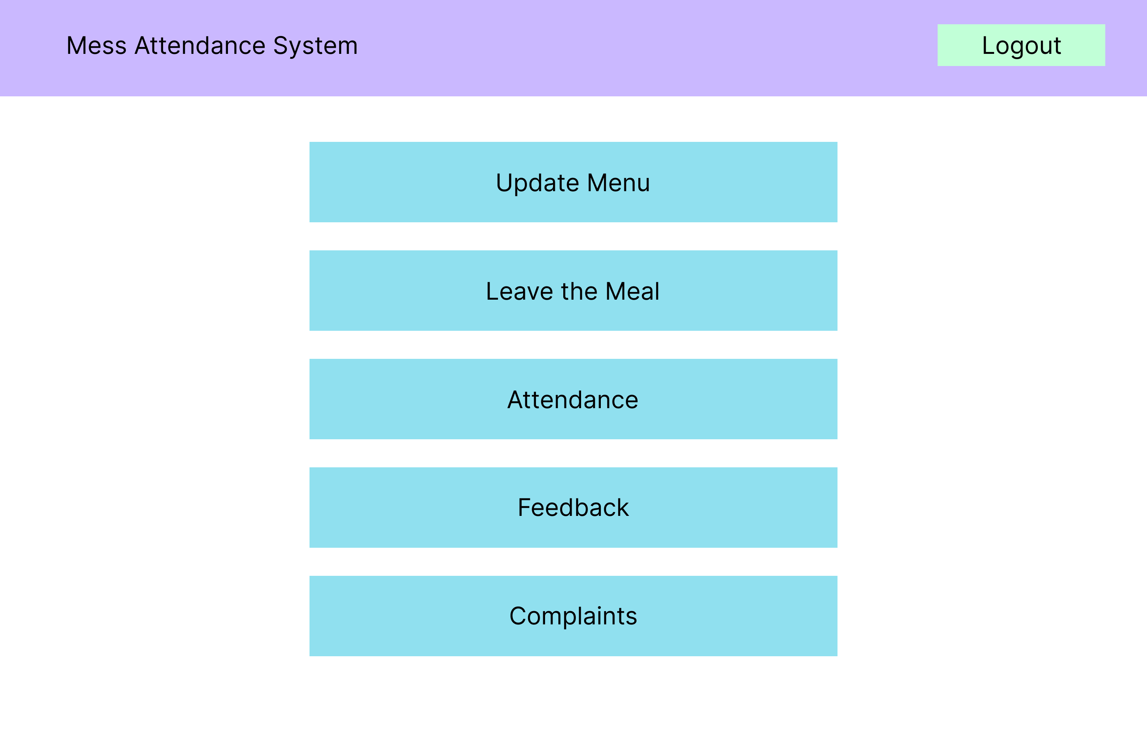
Mess Administration Features

Slide 8
College administration Features
1.Have a track of number of students attending the mess for every meal hour.
2.Get statistics of the attendance on daywise,weekly and monthly basis.
3.View the feedback and suggestions received.
4.View the complaints posted by the students and resolve them.

Slide 9
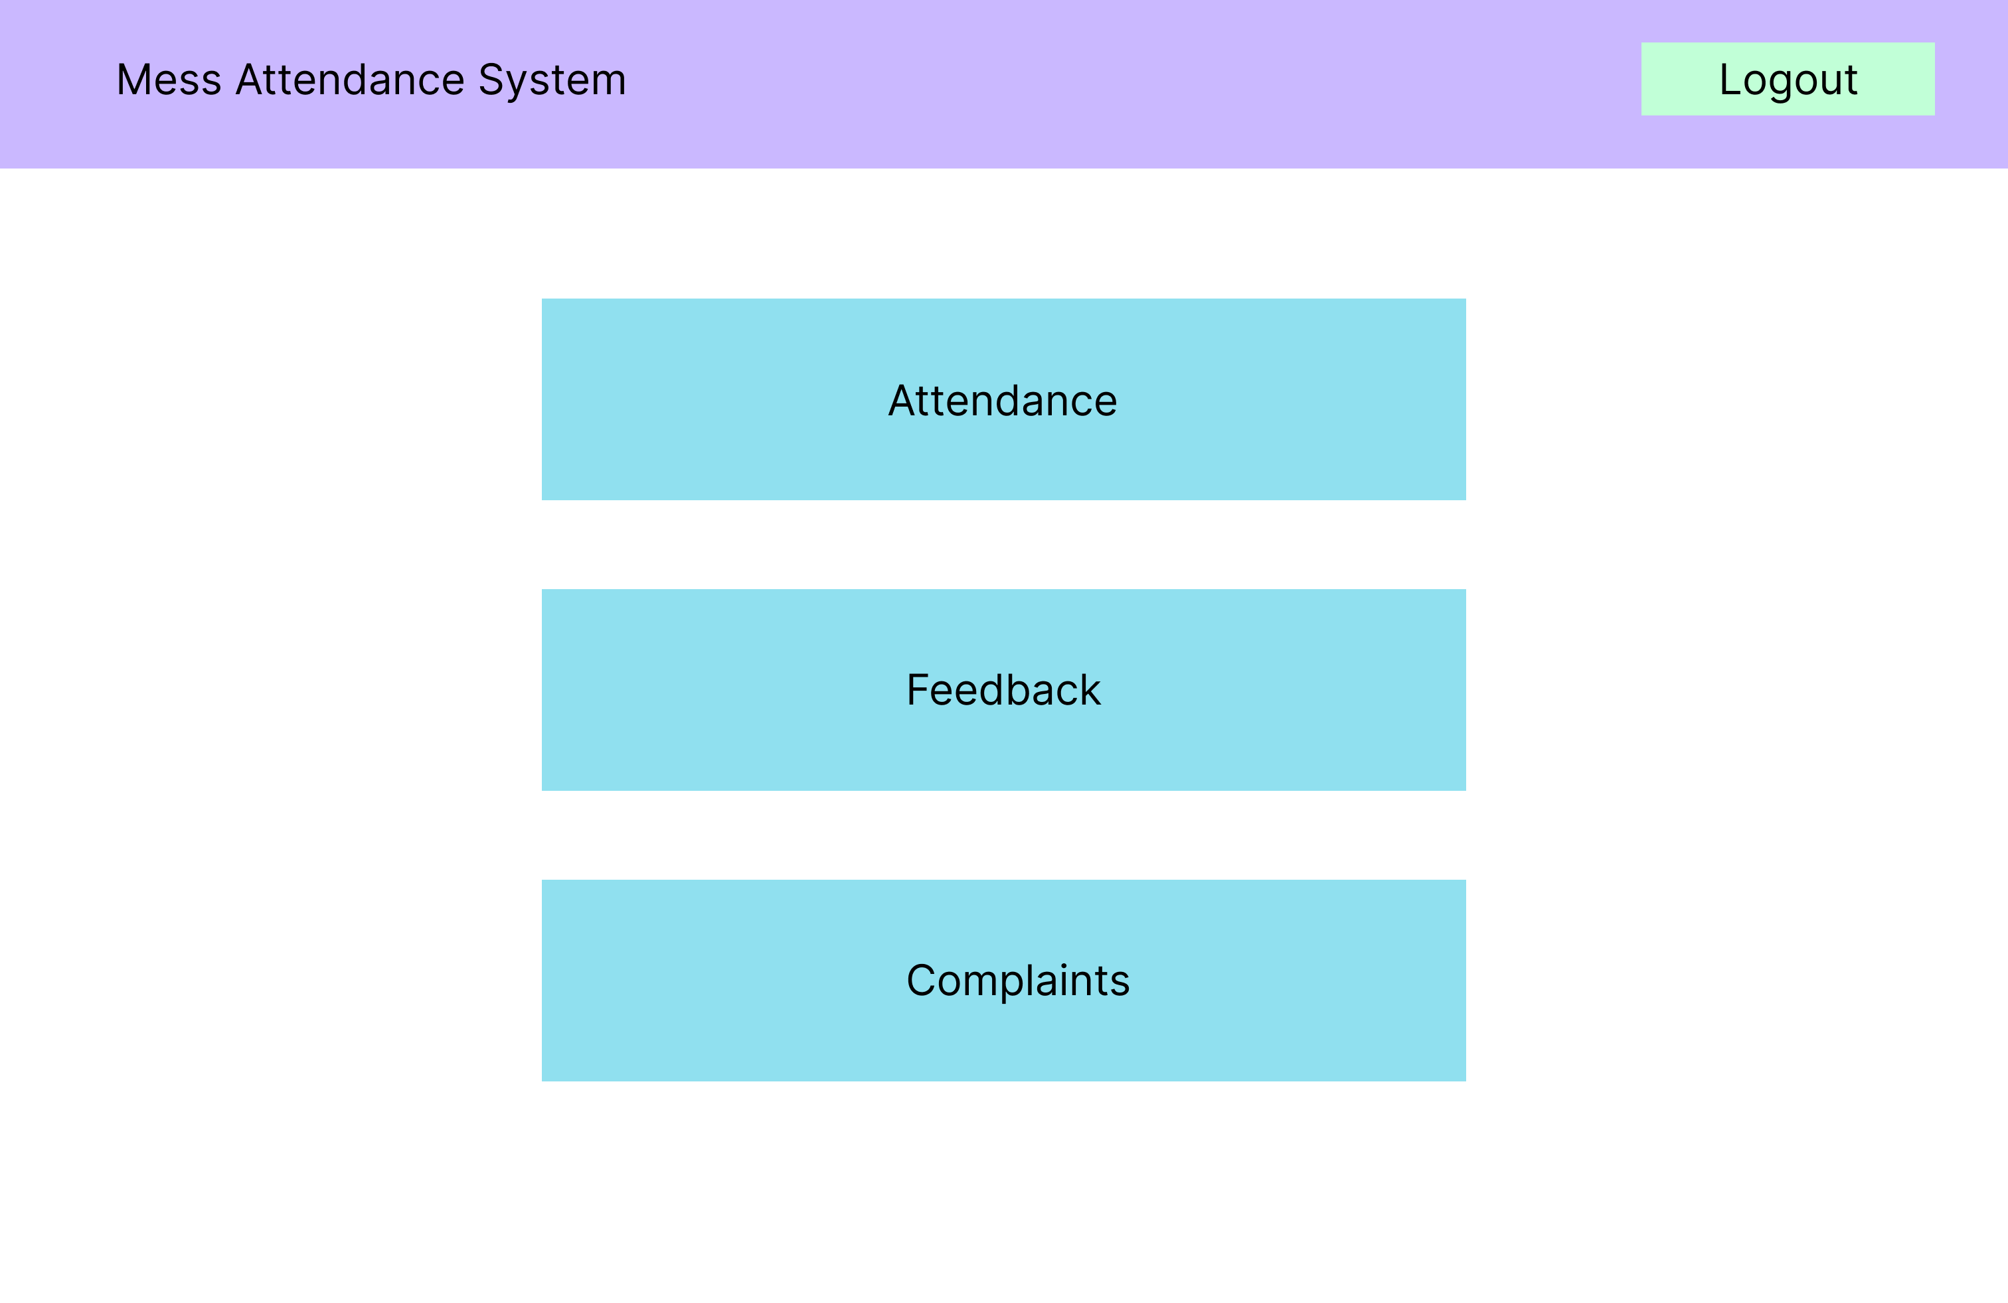
College Administration Features

Slide 10
Feedback
1. For every meal a random 5 students would be asked to give feedback, which helps in knowing how that particular meal was.
2.A weekly/monthly feedback should be submitted by each student.
Complaints
Students can post complaints regarding mess infrastructure or food.
These complaints can be posted in two ways, through instance snapshot from the phone and through text.

Slide 11
Prototype
Application Prototype
Website Prototype
Real time Application

Slide 12
Website Prototype
Mess Administration Portal

Slide 13
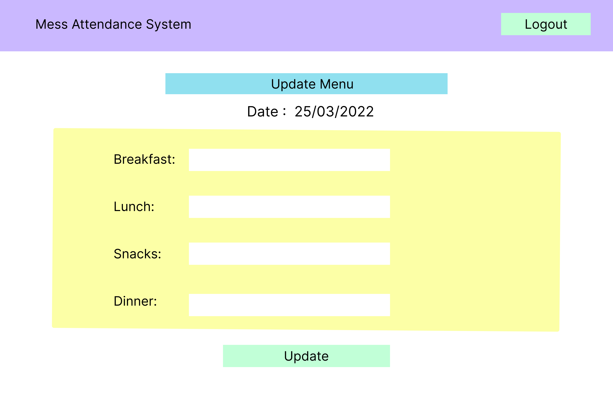
Update Menu Page

Slide 14
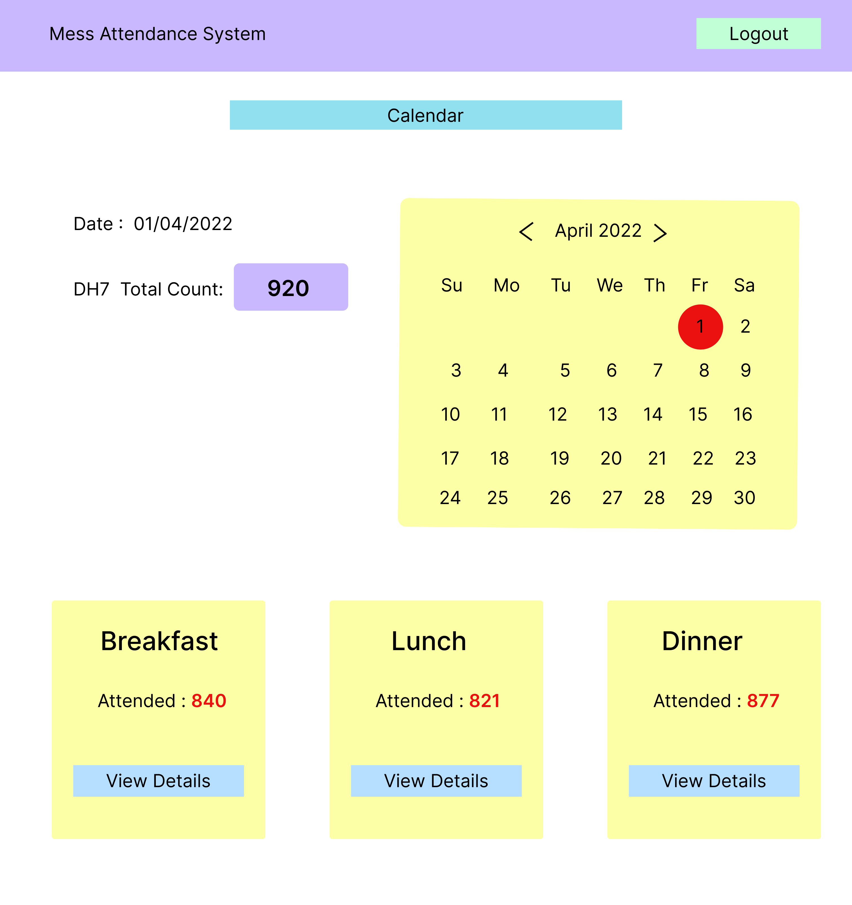
Attendance View Page

Slide 15
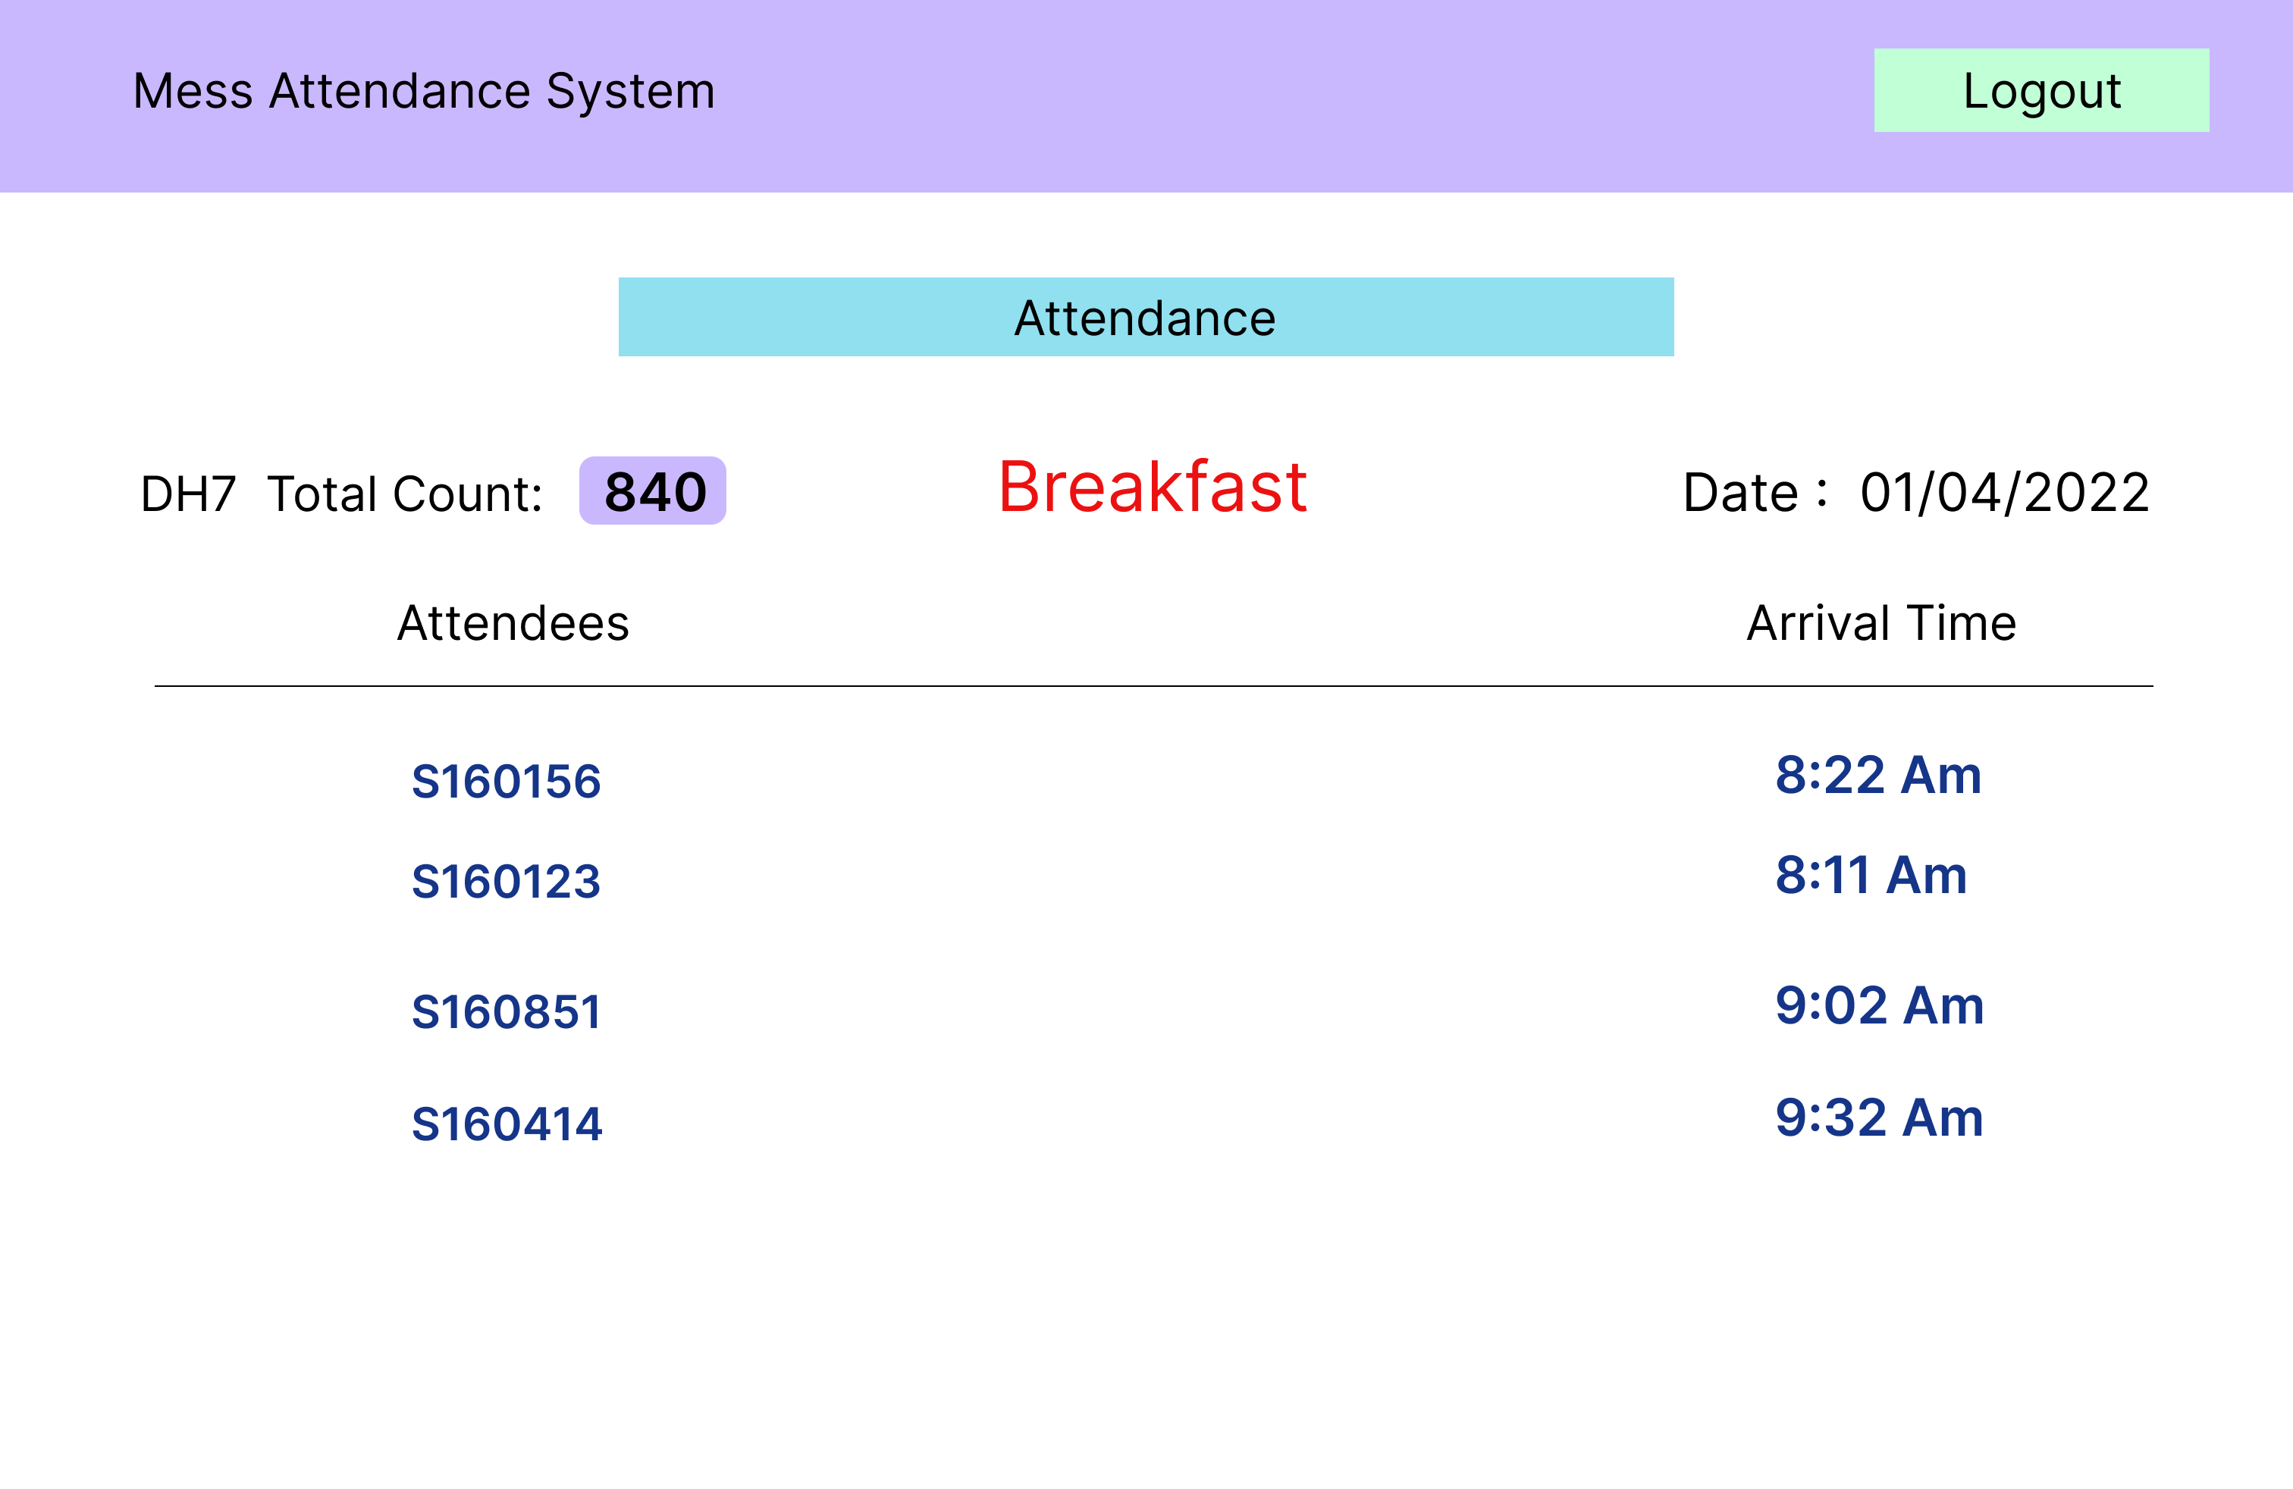
Attendance Detailed View Page

Slide 16
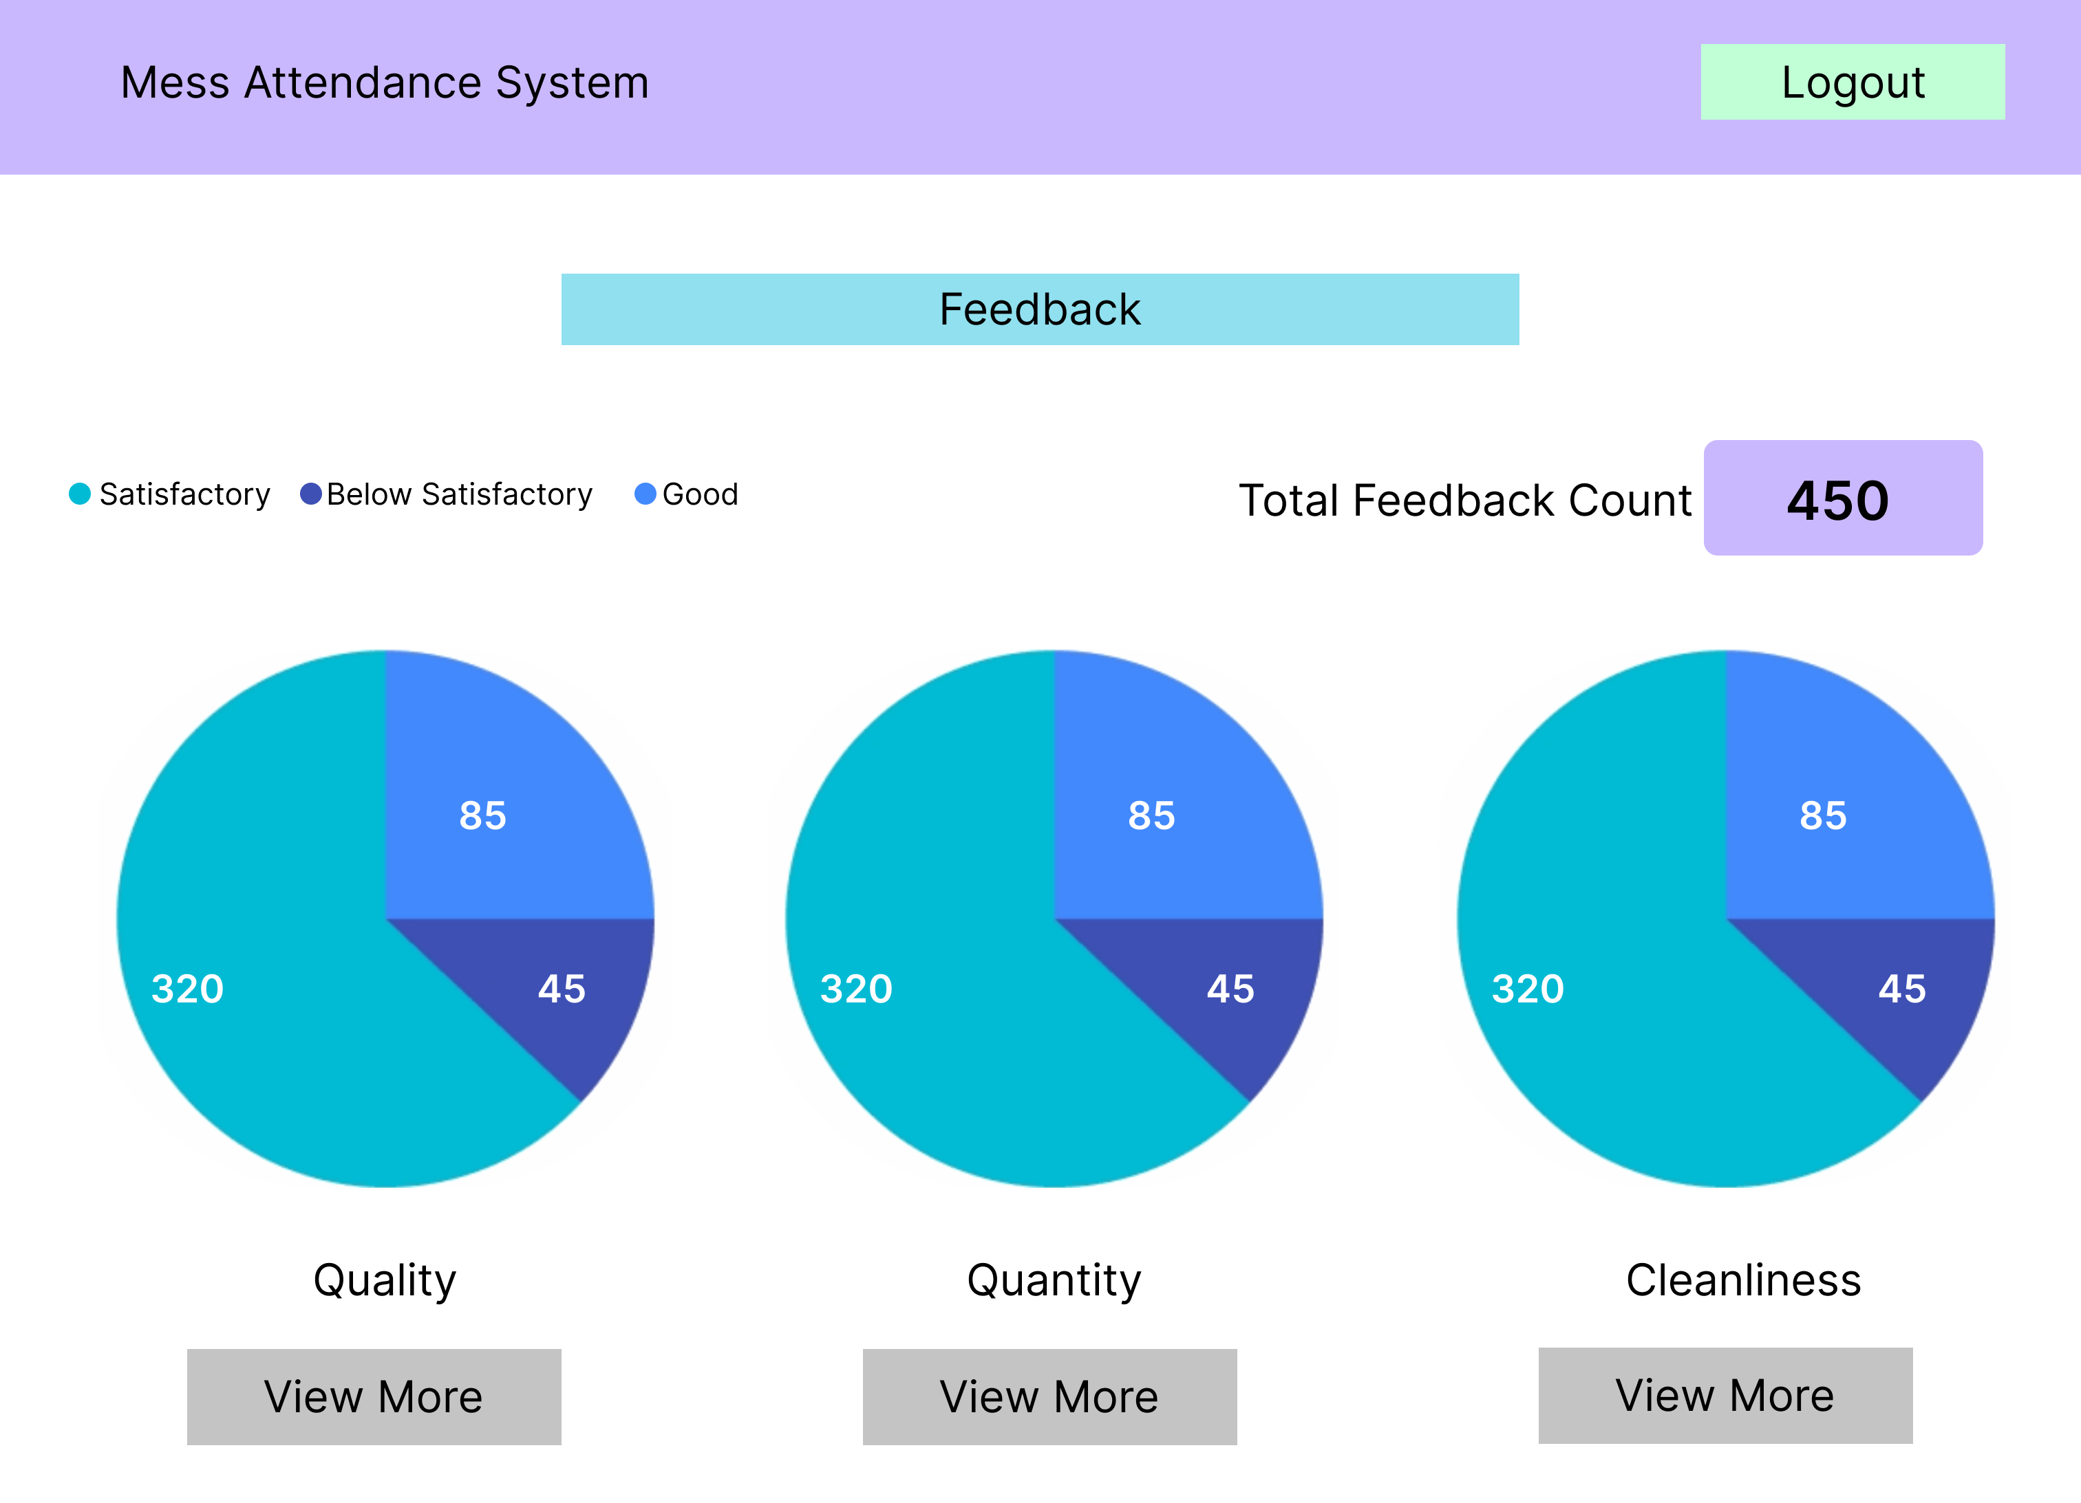
Feedback View

Slide 17
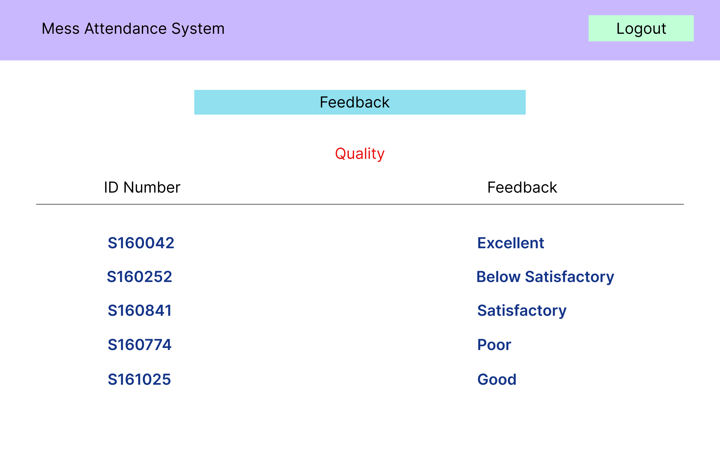
Feedback Detailed View Page

Slide 18
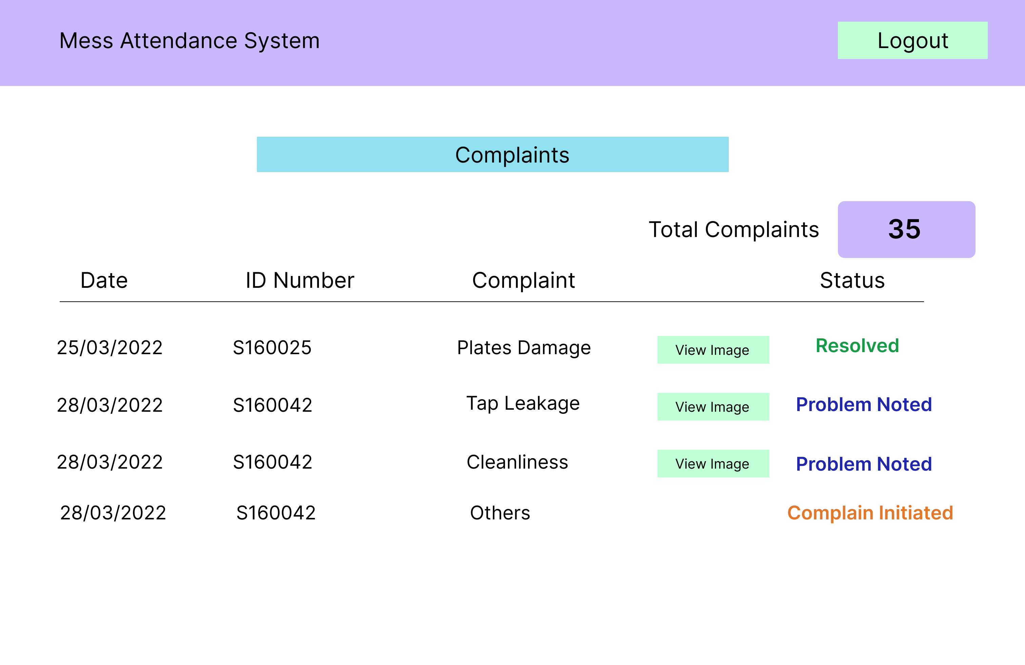
Complaints View Page

Slide 19
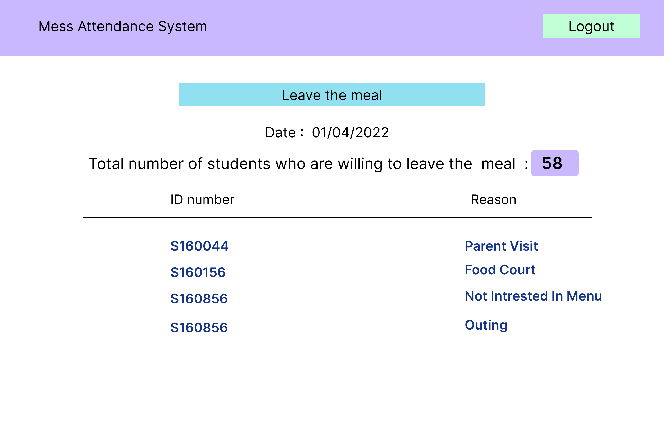
Leave the Meal

Slide 20
College Administration

Slide 21
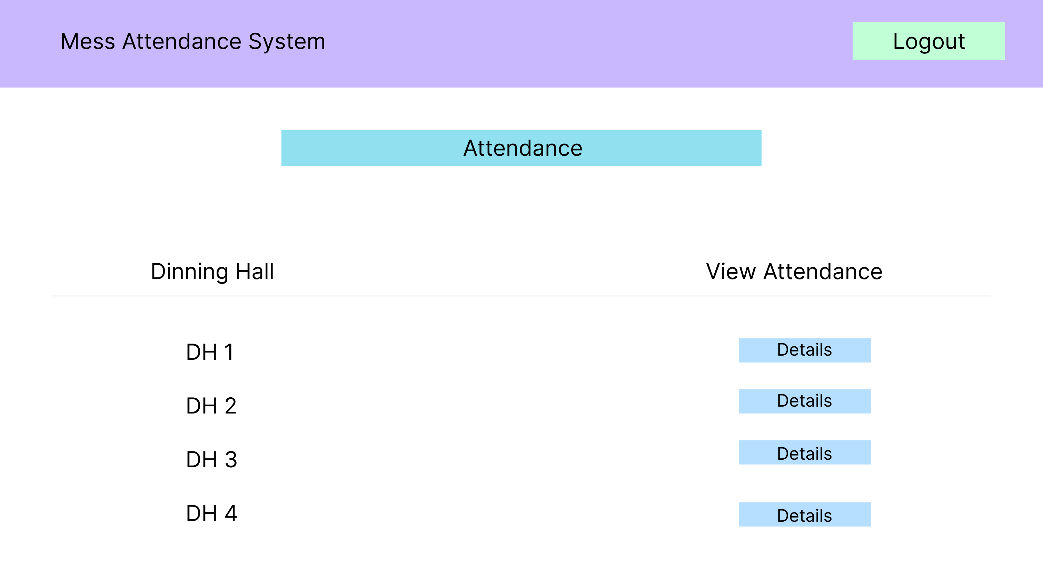
Attendance View

Slide 22
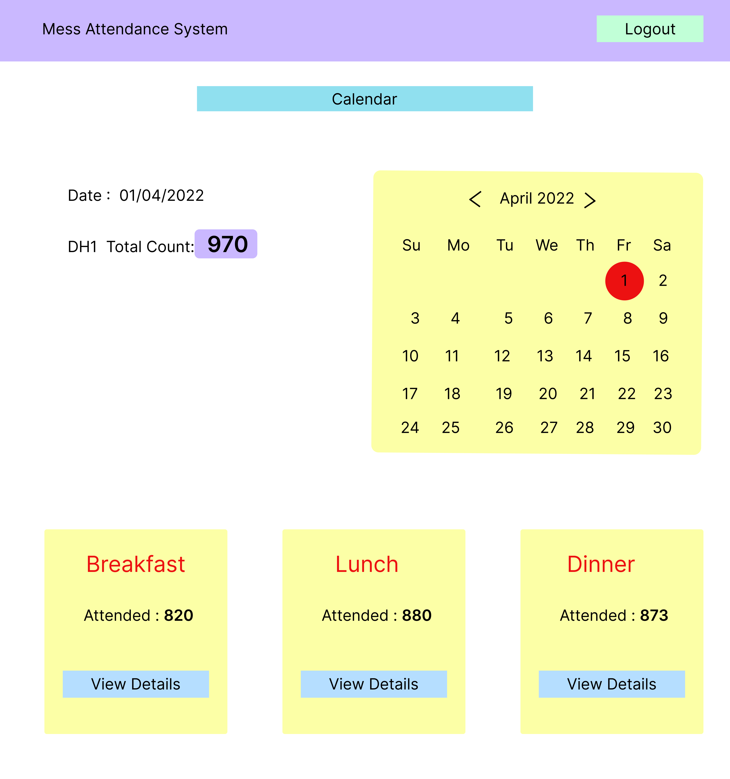
Mess Wise Attendance View

Slide 23
Feedback View

Slide 24
Feedback Detailed View

Slide 25
Complaints View

Slide 26
THANK YOU
ANY SUGGESTIONS ?

